Slide 1
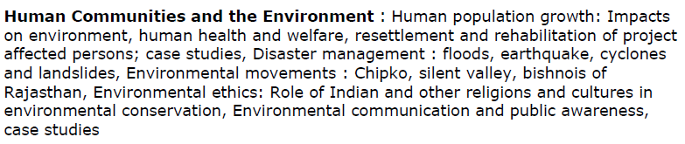
Unit 6
Human Communities and the Environment
Social issues and Environment-II
Population Explosion and Family welfare Program
Environment and Human Health
Environmental ethics
Diaster managemnt
Environmental movements
Role of an individual to protect environment

Slide 2
Disaster Management
Objectives:
Reduce, or avoid, losses from disasters
Assure assistance to victims
Achieve rapid and effective recovery
Disaster management:
Mitigation: Minimizing the possible effects of a disaster
Preparedness: Planning how to respond to a disaster
Response: Taking immediate measures to save life and property, providing medical relief, etc.
Recovery: Returning the community to normal conditions

Slide 3
Disaster
A disaster is defined as a sudden event or calamity that causes large-scale damage and destruction of human life and property.
Types of Disasters
Natural Disasters
Air-related – Hurricanes, cyclones, storms, etc.
Water-related – Floods, drought, etc.
Earth-related – Earthquakes, landslides, volcanic eruptions, etc.
Man-made Disasters
Industrial accidents
Wars, riots, terrorism, etc.
Toxic spills
Transportation accidents

Slide 4
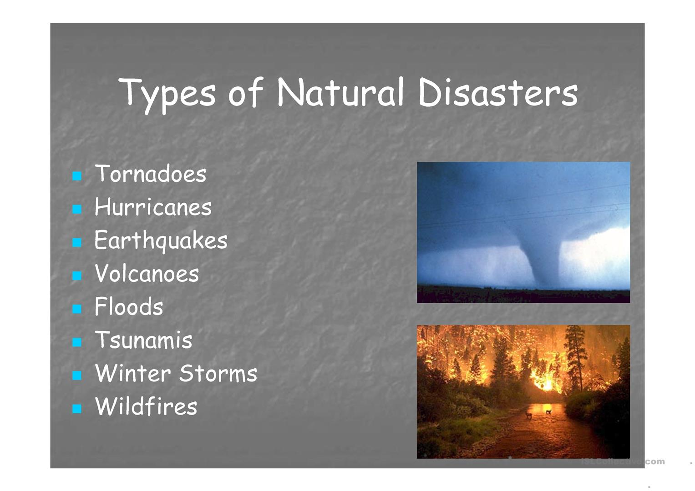

Slide 5
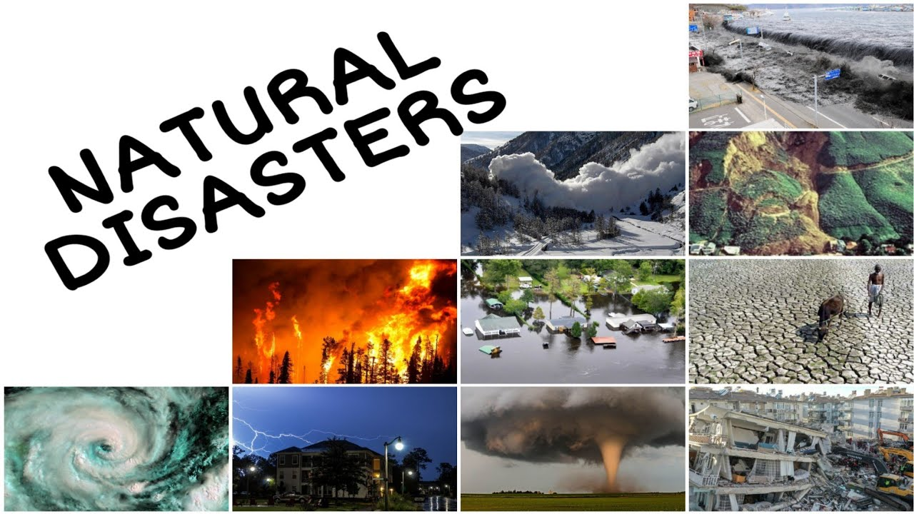

Slide 6
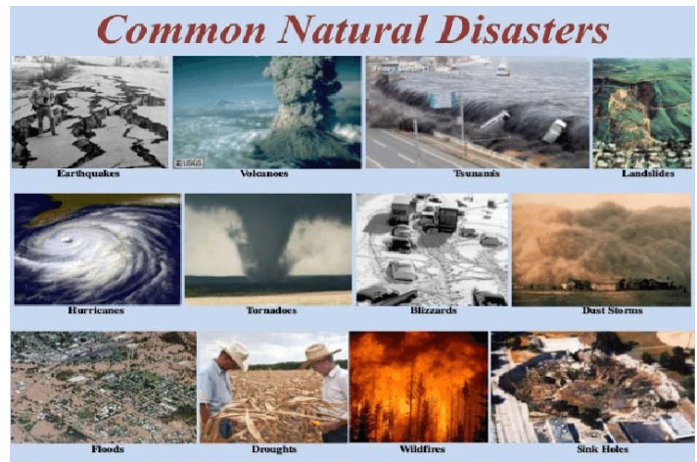

Slide 7
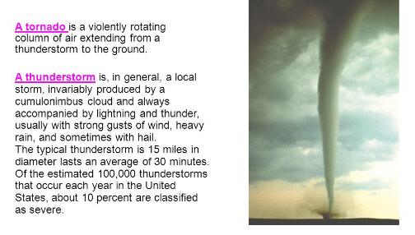

Slide 8
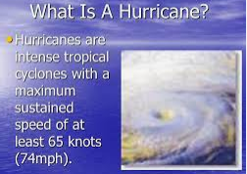

Slide 9
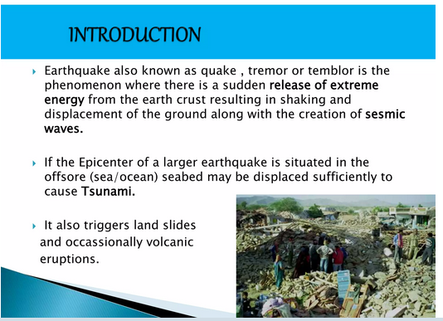

Slide 10
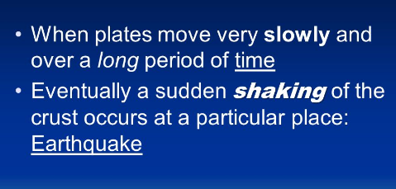

Slide 11
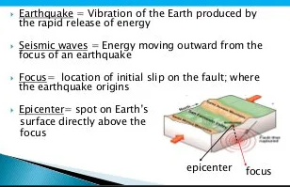

Slide 12
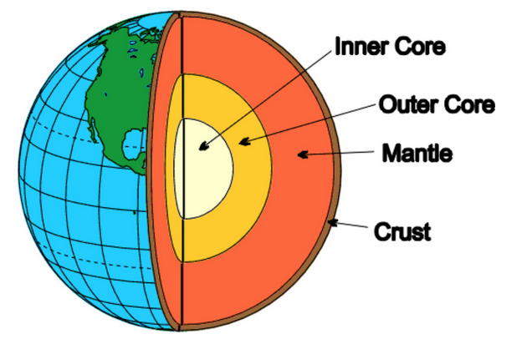

Slide 13
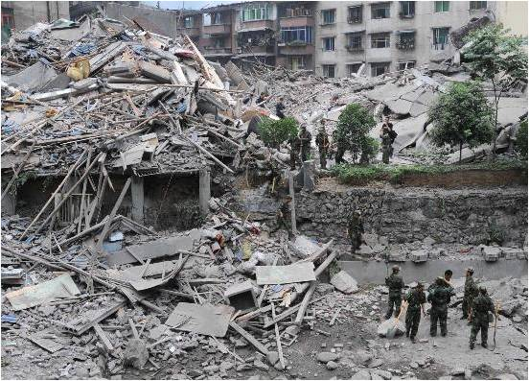
Earthquake
The term earthquake is used to describe any seismic event, caused naturally or as a consequence of human activities, that leads to the generation of devastating seismic waves.
Causes of Earthquake
Movement of hot gases and magma
Volcanic activities
Stress buildup due to water pressure
Tectonic stress generated by movement of tectonic plates

Slide 14
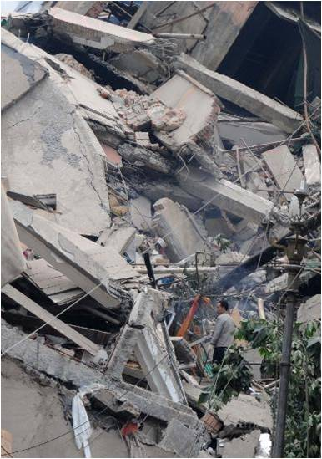
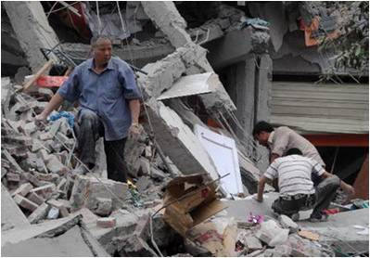
Effects of Earthquake
Destruction and demolition of buildings, dams, etc. Large-scale damage to life and property
Increased incidence of fire, landslides, etc.
Increased incidence of tsunami waves.

Slide 15
Management of Earthquakes
Marking earthquake-sensitive areas
Construction of houses, factories, dams, bridges, etc., with appropriate design and materials and strategically placed vibration absorbers
Forecast and early prediction of earthquakes
Creating public awareness regarding the steps to be taken during emergencies
Relief measures through timely support by individuals, government, and
non-governmental organizations

Slide 16
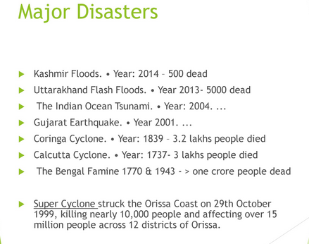

Slide 17
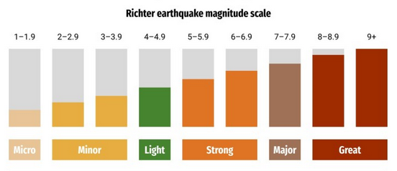

Slide 18
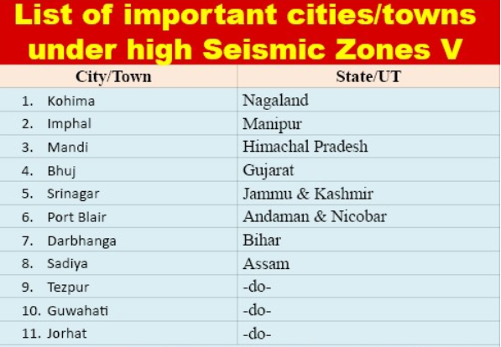

Slide 19
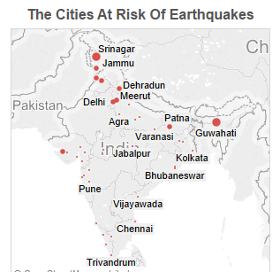

Slide 20
Landslides
Landslides are natural phenomena during which large amounts of landmass slide downwards from hilly areas, mainly because of gravity, destroying everything lying in the path.
Causes of Landslides
Earthquakes
Glaciers and Torrential rain
Construction of dams, bridges, tunnels, roads, etc
Use of explosives for breaking rocks during mining
Deforestation of mountain slopes

Slide 21
Landslides
Landslides are natural phenomena during which large amounts of landmass slide downwards from hilly areas, mainly because of gravity, destroying everything lying in the path.
Causes of Landslides
Earthquakes
Glaciers and Torrential rain
Construction of dams, bridges, tunnels, roads, etc
Use of explosives for breaking rocks during mining
Deforestation of mountain slopes

Slide 22
Effects of Landslides
Rocks, large debris, and sliding landmasses destroy urban and rural habitation
Damage to roads, dams, bridges, etc.
Obstruction of river flow increasing the incidence of flood
Severe damage to crops and agricultural lands
Management of Landslides
Construction activities should be done only after properly evaluating the geological and geographic conditions.
Regulating rate of water flow also helps in controlling landslides.
Agriculture at slopes should be avoided as far as possible.
Relief task through economic help supporting resettlement and rehabilitation
of affected people at individual, community, and organizational levels should be carried out.

Slide 23
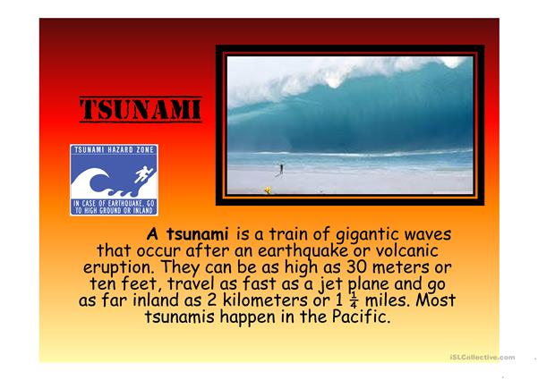

Slide 24
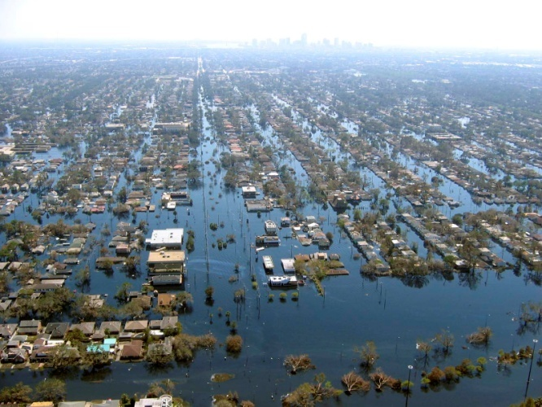
Floods
The accumulation of a large quantity of water at a place or the presence of more water than can be handled by the drainage of the area is known as flood.
Types of Floods
Flash floods
River floods
Coastal floods
Causes of Floods
Deforestation
Urbanization
Change in river course
Man-made activities in river channels
Uncertain rainfall

Slide 25
Effects of Floods
Damage to agricultural crops
Damage to life and property
Disturbances in transportation
Increase in populations of disease vectors and pathogens
Loss of biodiversity
Economic crisis
Control of Floods
Plantation on slopes
Drainage management
Flood plain zoning
Forecasting

Slide 26
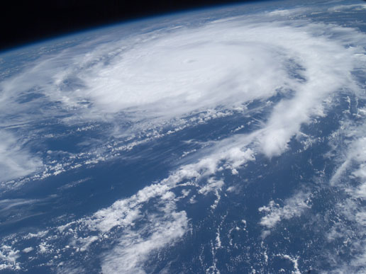
Cyclones
In northern hemisphere, a cyclone refers to an area of low atmospheric pressure surrounded by a wind system in a counter-clockwise direction.
Effects of Cyclones
They damage installations,
communication systems,
trees, etc., resulting in loss of life
and property.
They may cause river floods and
submergence of low-lying areas.

Slide 27
Management of Cyclones
Forecasting
Proper construction of houses and Construction of cyclone shelters in the
cyclone-prone areas
Relief tasks
Development of warning systems
Community preparedness at all levels to deal with emergency situations

Slide 28
Environmental movements
BISHNOI MOVEMENT : it was started in 400 years ago by a Sage known as Sombaji. in Rajasthan, a large number of trees are still worshiped by devotees. people resisted the cutting of such tree & advocated movement against deforestation.
CHIPKO MOVEMENT : It was started in 1973 is the Chamoli district of Uttranchal, Chipko movement was against deforestation. Sunderlal Bahueguna , Gauri devi & Chandi Prasad Bhatt were prominent leaders of this movement.
NARMADA BACHAO ANDOLAN : it is a movement against building multi-purpose dam over Narmada river which will ultimately result in flood & water logging in large area covered by about 1,00,000 people. the movement is led by Medha Potekar, Baba Amte & Arundhati Roy.
SILENT VALLEY MOVEMENT : it was a movement against a hydro-electric project on the river Kuthipuzha, atributory at Preiyar river. in fact, the project site is covered by evergreen forest which is a home of many rare species of plants & fauna which may be destroyed by submergence.
BALIYAPAL MOVEMENT : It is a movement against testing of missiles on the land of Baliyal villagers which may lead to interfertitlity of soil.
http://sathitech.blogspot.in/2009/09/environment-movements-in-india.html

Slide 29
Video Links
Disaster management
https://www.youtube.com/watch?v=Kt-C8WCIWrg
Earthquake
https://www.youtube.com/watch?v=8HKx8b_yc50
Cyclone
https://www.youtube.com/watch?v=-AAG4HEsgMQ
https://www.youtube.com/watch?v=x6SQbSmvzQM
Landslides
http://video.nationalgeographic.com/video/101-videos/landslides

Slide 30
1. Who among the following was associated with Bishnoi movement?
A. Amrita Devi
B. Gaura Devi
C. Govind Singh Rawat
D. Shamsher Singh Bisht
2. Who among the following was associated with chipko movement?
A. Sundarlal Bahuguna
B. Gaura Devi
C. Sudesha Devi
D. All of the above

Slide 31
1. Who among the following was associated with Bishnoi movement?
A. Amrita Devi
B. Gaura Devi
C. Govind Singh Rawat
D. Shamsher Singh Bisht
Ans: A
Explanation: Amrita Devi sacrificed her life along with her three daughters in year 1730 during Bishnoi movement to save green trees being felled by the Maharaja of Jodhpur at a place known as Khejarli in Marwar, Rajasthan. Hence, A is the correct option.
2. Who among the following was associated with chipko movement?
A. Sundarlal Bahuguna
B. Gaura Devi
C. Sudesha Devi
D. All of the above
Ans: D
Explanation: The Chipko movement or Chipko Andolan was primarily a forest conservation movement in India that began in 1973. It was a movement that practised the Gandhian methods of Satyagraha where both male and female activists played vital roles, including Gaura Devi, Sudesha Devi, Bachni Devi, Chandi Prasad Bhatt and Sundarlal Bahuguna.Hence, D is the correct option.

Slide 32
3. Which of the following was started in 1973 to save the evergreen tropical forest in the Palakkad district of Kerala, India from being flooded by a hydroelectric project?
A. Chipko Movement
B. Silent Valley Movement
C. Appiko Movement
D. Jungle Bachao Andola
4. Which environmental movement refers to as Greed Game Political Populism by the environmentalists?
A. Narmada Bachao Andolan (NBA)
B. Silent Valley Movement
C. Appiko Movement
D. Jungle Bachao Andola

Slide 33
3. Which of the following was started in 1973 to save the evergreen tropical forest in the Palakkad district of Kerala, India from being flooded by a hydroelectric project?
A. Chipko Movement
B. Silent Valley Movement
C. Appiko Movement
D. Jungle Bachao Andola
Ans: B
Explanation: Save Silent Valley was a social movement aimed at the protection of Silent Valley, an evergreen tropical forest in the Palakkad district of Kerala, India. It was started in 1973 to save the Silent Valley Reserve Forest from being flooded by a hydroelectric project. Hence, B is the correct option.
4. Which environmental movement refers to as Greed Game Political Populism by the environmentalists?
A. Narmada Bachao Andolan (NBA)
B. Silent Valley Movement
C. Appiko Movement
D. Jungle Bachao Andola
Ans: D
Explanation: The tribals of Singhbhum district of Jharkhand started the protest when the government decided to replace the natural sal forests with the highly-priced teak which was called ‘Jungle Bachao Andola’. This movement was also called by many as “Greed Game Political Populism”.

Slide 34
5. Match the following:
Set I
a. Narmada Bachao Andolan (NBA)
b. Silent Valley Movement
c. Appiko Movement
d. Jungle Bachao Andola
Set II
1. Medha Patkar, Baba Amte, Adivasis, farmers, environmentalists and human rights activists
2. Kerala Sastra Sahitya Parishad (KSSP) an NGO, and the poet activist Sughathakumari
3. Uttara Kannada and Shimoga districts of Karnataka State
4. Against government’s decision to replace the natural sal forest with Teak
Code:
a b c d
A. 1 2 3 4
B. 4 2 3 1
C. 3 4 1 2
D. 1 4 2 3

Slide 35
5. Match the following:
Set I
a. Narmada Bachao Andolan (NBA)
b. Silent Valley Movement
c. Appiko Movement
d. Jungle Bachao Andola
Set II
1. Medha Patkar, Baba Amte, Adivasis, farmers, environmentalists and human rights activists
2. Kerala Sastra Sahitya Parishad (KSSP) an NGO, and the poet activist Sughathakumari
3. Uttara Kannada and Shimoga districts of Karnataka State
4. Against government’s decision to replace the natural sal forest with Teak
Code:
a b c d
A. 1 2 3 4
B. 4 2 3 1
C. 3 4 1 2
D. 1 4 2 3
Ans: A
Explanation:
Narmada Bachao Andolan (NBA): Medha Patkar, Baba Amte, Adivasis, farmers, environmentalists and human rights activists.
Silent Valley Movement: Kerala Sastra Sahitya Parishad (KSSP) an NGO, and the poet activist Sughathakumari
Appiko Movement: Uttara Kannada and Shimoga districts of Karnataka State
Jungle Bachao Andola: Against government’s decision to replace the natural sal forest with Teak.

Slide 36
6. Disaster Management includes:
a. Mitigation
b. Reconstruction
c. Rehabilitation
d. All of the above
7. Tsunami’s can occur only during
Evening
Afternoon
Any time of the day or night
Morning
8. United Nations disaster management team are responsible for solving problems resulting from disaster in
Asia
Africa
Australia
All continents
9. In India National Institute of Disaster Management is located at
Manipur
Punjab
Hyderabad
New Delhi

Slide 37
6. Disaster Management includes:
a. Mitigation
b. Reconstruction
c. Rehabilitation
d. All of the above
7. Tsunami’s can occur only during
Evening
Afternoon
Any time of the day or night
Morning
8. United Nations disaster management team are responsible for solving problems resulting from disaster in
Asia
Africa
Australia
All continents
9. In India National Institute of Disaster Management is located at
Manipur
Punjab
Hyderabad
New Delhi

Slide 38
For MCQ link :
https://www.jagranjosh.com/general-knowledge/gk-questions-and-answers-on-the-environmental-movements-in-india-1519046494-1
http://bbmc.nic.in/sites/default/files/100_questions_DM.PDF

Slide 39
Thank you
Good luck ..!!

